Slide 1
Team 8
Breathalyzer

Slide 2
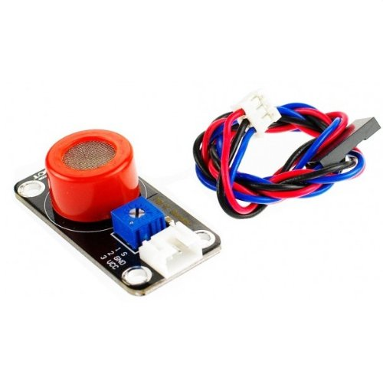
Breathalyzer
Uses an MQ-3 alcohol sensor
High sensitivity to alcohol that can be adjusted using a 10k pot
Ethanol in breath is oxidized to acetic acid and the current produced by reaction is measured to determine BAC.

Slide 3
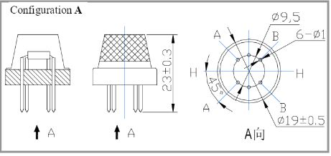
Design
Breathalyzer running on an Arduino Uno
Reads blood alcohol content of user
Utilizes push button to decide when to read from the sensor
Sensor housed in an asthma inhaler with an lcd display that prints the BAC value of the user
Internal Schematic

Slide 4
General Concept
The MQ-3 gas sensor uses a tin dioxide and aluminum plate. Ethanol is breathed into the sensor and converted to acetic acid. The Acetic Acid acts as a buffer between the two plate and allows for the transmission of a current.
The more ethanol, the more current. The reading of the current is used to determine blood alcohol content(BAC).

Slide 5
Milestones
Decided on general design
Implemented this design and developed case to hold breathalyzer
Currently working on calibrating breathalyzer and debugging

Slide 6
Potential Risks
Moisture in breath can also affect the sensor. This will be dealt with by instructing the user to breathe on the sensor from a distance of several inches instead of pressing the mouth against it.
The sensor is difficult to calibrate with the information in the data sheet. Currently the sensor will be calibrated with the help of functioning police breathalyzer.
The MQ-3 sensor uses a heater next to the electrode which provides “necessary conditions” for working components. There is a risk that enough time will not be given for the warmup as the datasheet does not provide a warmup time or temperature.

Slide 7
Individual Role/Responsibilities
Jordan
Chris
Josh
Taylor
Drew
Serin

